Slide 1


Project Integration Management
1

Slide 2




Integration Management Overview
Table of content
Integration Management Processes
Integration Management in Agile Summary

Slide 3


Objective
After this session, the attendees shall:
Understand why we need integration in project management
Have an overall picture of how we manage a project
Know what a PM needs to make a project successful
Get best practice of running Waterfall or Agile project
Be confident to take any kinds of project in FSOFT

Slide 4
Integration Management Overview

Slide 5
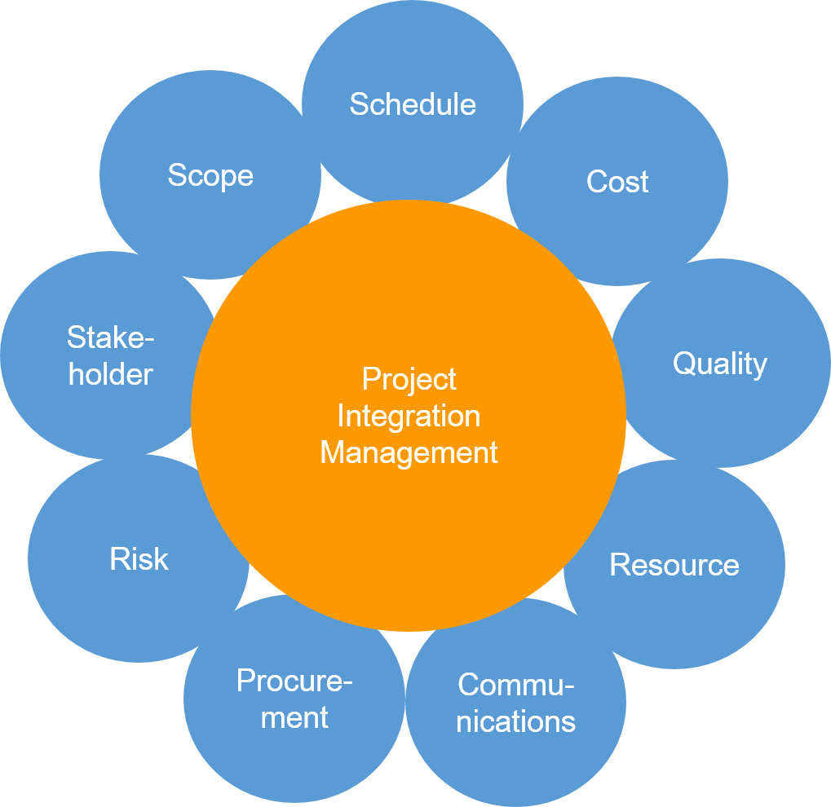
Why Integration Management?
Activity Coordination
Ensure proper coordination between project activities
Teamwork
Ensure there is collaboration between stakeholders and all information is
synchronized.
Tracking
Track the procedures undertaken during the project life cycle and distribute
information to all stakeholders
Knowledge
Ensure project knowledge is retained and be accessible at organization level

Slide 6
Key Processes in Integration Management
Develop project charter
Develop project management plan
Direct & Manage Project Work
Monitor and Control Project Work
Close Project or Phase
Perform Integrated Change Control
Manage Project Knowledge

Slide 7
Develop Project Charter

Slide 8


Why Project Charter?
Project Charter Key Contents
Business Case & Project Purpose
Measurable Project Objectives and related success criteria
High-level Requirements
Budget
Milestone
Assumptions and constraints & risks
Assigned PM, responsibility, and authority level
Project Existence It formally authorizes the existence of the project and provides a reference source for the future
PM Authority Give PM the power to utilize organizational resources to accomplish the project objectives
Direction
Give a direction and a sense of purpose to the
management from start to end
Business Value
Identify how the project is aligned with the
organizational strategies

Slide 9
Develop Project Management Plan

Slide 10






What comprises Project Management Plan?
Project Summary
The project information, life cycle,
development approach, management
process and review
Baseline
Scope baseline Schedule baseline Cost baseline
Subsidiary plans
The management plans for scope, requirement, schedule, cost, quality, resources, communications, risk, procurement, and stakeholder
Change Management Plan
Describe how changes will be managed
and controlled
Configuration Management Plan
Define the naming conventions, the version control system, and the document storage and retrieval system

Slide 11
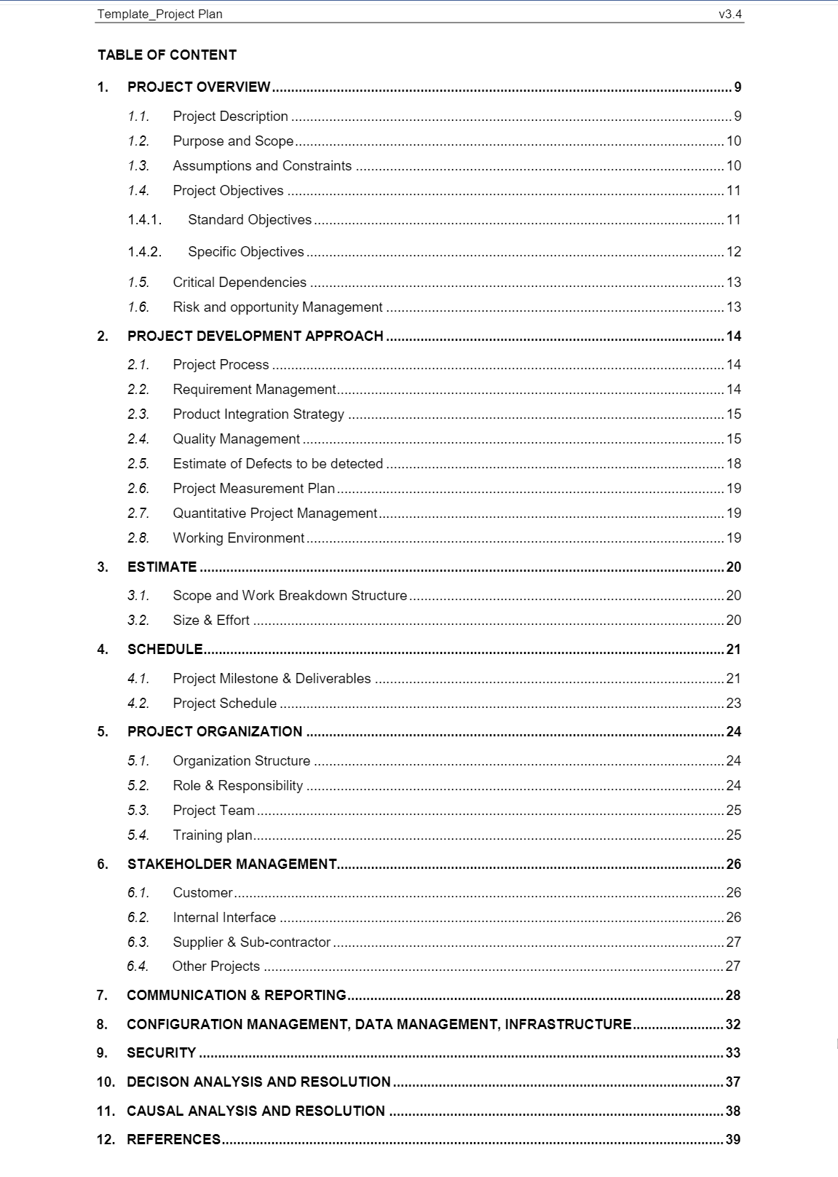
Project Plan in FSoft
Project Type | Project Plan | Description
Very Light | Workbook | Project Planning Project Defined Process Requirement Management Plan Risk & Issue Management plan Communication Plan Quality Plan CM, Data Management, Infrastructure
Light | Workbook | Project Planning Project Defined Process Requirement Management Plan Estimation Staff Management Plan Risk & Issue Management plan Communication Plan Quality Plan CM, Data Management, Infrastructure Product Integration Plan Review and Test Strategy Causal Analysis Resolution Defect detected estimation Task category and Task complexity
Standard | Word | Look at the image →
3/18/2021
43e-BM/HR/HDCV/FSOFT V1.2 - ©FPT SOFTWARE – Corporate Training Center
12

Slide 12








Project Kick-off
» Hold a kickoff meeting with key stakeholders, team members, functional managers, sponsor and the customers to make sure everyone is on the same page and to gain buy-in.
» Kick-off meeting slides example:

Slide 13
Direct and Manage Project Work

Slide 14

How to Manage Project Work Effectively
Leader Skills
Communication and
interpersonal skills
Ability to negotiate and
resolve conflicts
Decision Making
Knowledge
Technical & Process
Use the right tool for project management
Manage in a whole knowledge areas
Facilitator
Build environment
Self-organizing team
Building commitment
within the team

Slide 15
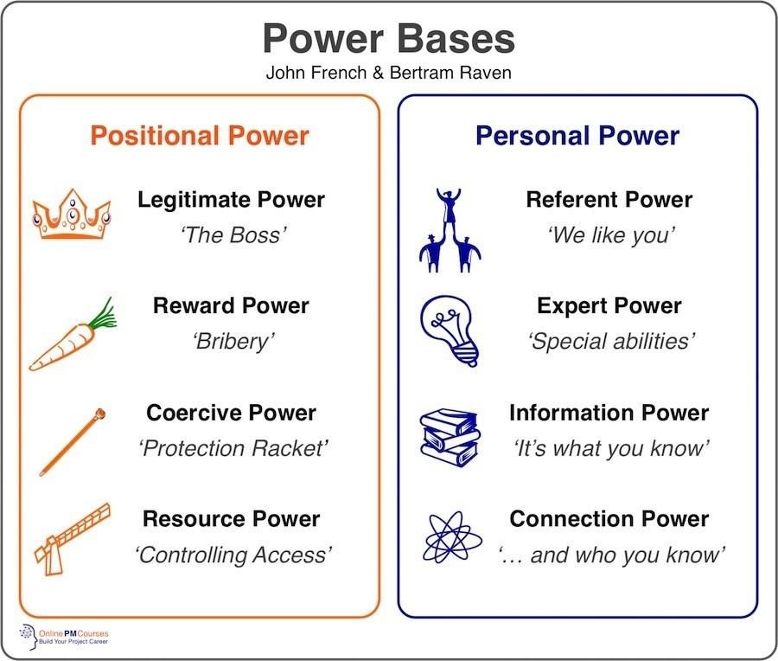

PM Power in Project Management

Slide 16
Manage
Project Knowledge

Slide 17
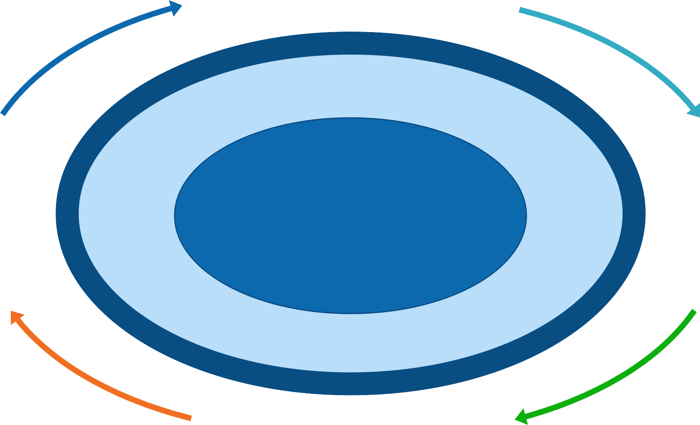
Why we need to manage Project Knowledge
Reference
•
•
Document
Knowledge Types:
Capture
Explicit
Tacit
Categorize
Create
Discover
•
Identify
Retrieve
Exchange
Classify
Adopt
Transfer
Protect
Knowledge Areas:
•
Management
Procedures
Technical
Costing
Supplier & Client
Legal & Statutory
Who knows what
Distribute
Access
Maintain
Renew
Secure
•
Share
Destroy
Obsolete
File
•
•
Archive

Slide 18








How To Manage Project Knowledge
Build Culture of Trust
Documentation Approaches
Communicate often
Empower and recognize
Build relationship
Show vulnerability
Electronic/Hard copy
Stand Alone/Premise/Cloud
Communication Methods
Learn from experience of
Informal: Interpersonal skill
Formal: Training, Seminar,
Workshop
Mistake
Best Practice
Lesson Learned
Aware of constraints
Maintain knowledge
Legal and Regulatory
Restriction of sharing
Versioning
Access Right
Tools & Process

Slide 19

High TOR and knowledge management
» Working in ODC with high TOR
» Problem: How to retain knowledge
» Actions:
» Create knowledge database
» Mentor & cross-train your team members
» Develop a knowledge transfer strategy
» Convince team member to stay:
» Build ODC culture
» Clear career path
» Motivation with challenges and opportunities
» Income
» Result:
» Strong ODC with rich handbook and document database
» Strong training & sharing program

Slide 20
Monitor & Control Project Work

Slide 21
How to monitor and control project work?
Direct and manage
project work
Work Performance Data
Validate Scope
Control Schedule
Control Cost
Control
Procurement
Control
Communication
Control Stakeholder Engagement
Control Scope
Control Quality
Control Risk
Work Performance Information
Update Project Plan
Change Request
Monitor and control
project work
Work Performance Report
Update Project Document
Perform Integrated Change Control
Manage
Communication
Manage Project Team
Control Procurement
Control Risk

Slide 22
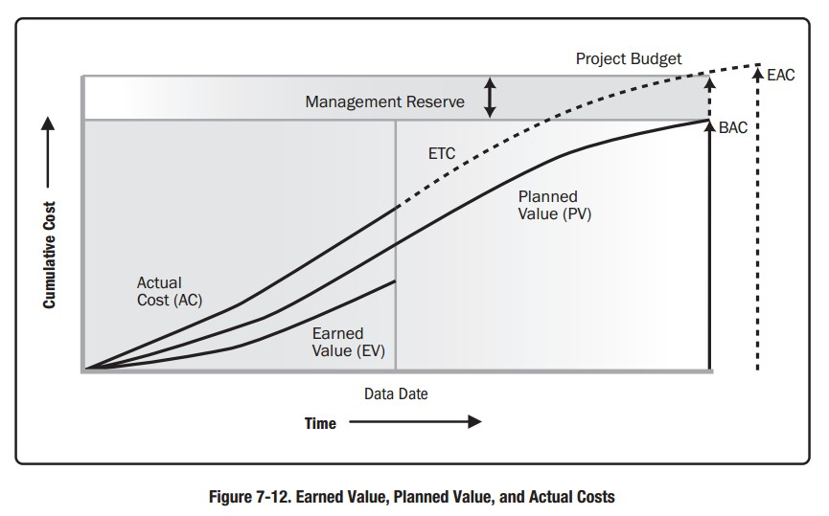
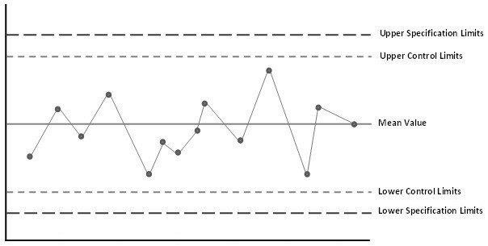
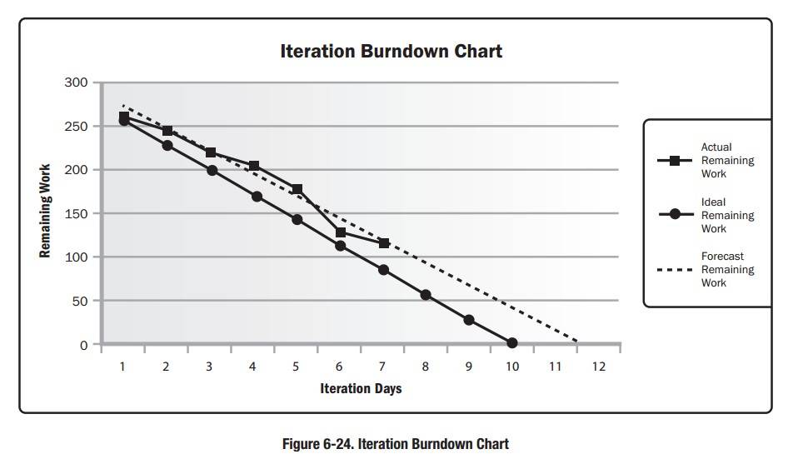
Common Tools for monitoring & controlling
Trend Analysis
S-Curve: EV, PV, AC
Burn-down Chart
Iteration Remaining Effort
Control Chart
Process Measurement

Slide 23
Perform Integrated Change Control

Slide 24
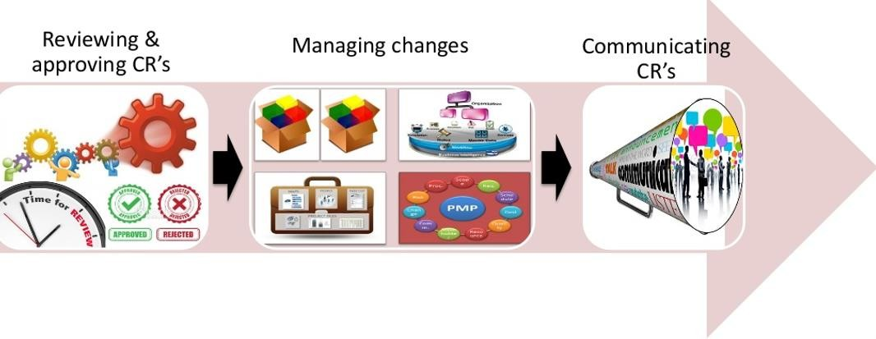
What is Integrated Change Control?

Slide 25
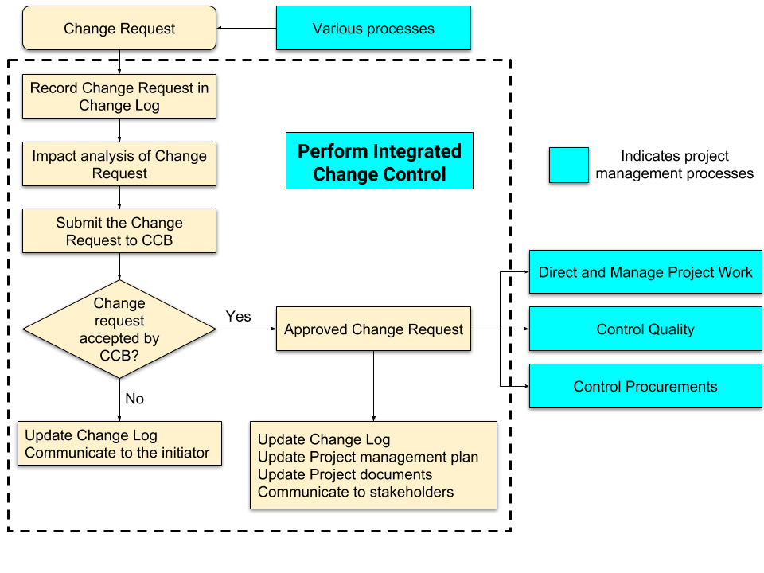
Integrated Change Control Process

Slide 26
Close
Project or Phase

Slide 27
Close Project or Phase
» Finalize all activities to formally complete the project or phase
» Provide:
» Lesson learned
» Formal ending of the project work
» Release organization resources to pursue new endeavors

Slide 28
Integration Management in Agile

Slide 29
Agile Manifesto Values
Individuals and interactions
over processes and
tools
Working Software
over comprehensive
documentation
Responding to Change
over following a plan
Customer Collaboration
over contract
negotiation

Slide 30
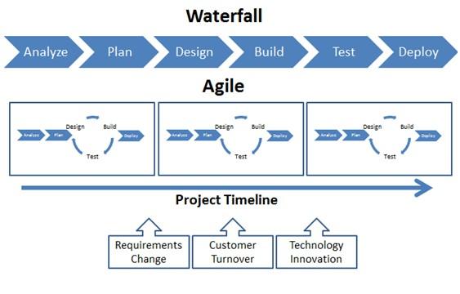
Agile Project & Waterfall Project
» PM vs Scrum Master
» Planning in Agile?
» How to direct and monitor project work in Agile?
» How to manage knowledge in Agile?
» How to manage change request in Agile?

Slide 31
Agile-Waterfall Hybrid Model
» Customer just has fixed budget and hard deadline but still wants to apply Agile
development approach
» Trade-off: having to keep some level of planning and structure while aiming to reap the
benefits of an iterative, flexible, collaborative approach
» How:
» Planning with Waterfall but development with Agile/Scrum
» Involve PO & client into communication regularly
» Set expectation and define Acceptance Criteria
» Make clear about triangle (Scope – Cost – Schedule)
Maintenance
Iteration
Verification
Implementation
Design the model
Requirement

Slide 32
Summary

Slide 33
Summary
In this course, you already learned:
» Integration Management Overview
» What is Integration Management
» Why Integration Management
» Integration Management Process
» Develop Project Charter
» Develop PMP
» Direct & Manage Project Work
» Manage Project Knowledge
» Monitor & Control Project Work
» Perform Integrated Change Control
» Close Project or Phase
» Integration Management in Agile
» Value-based & Plan-based
» Case Studies in FPT

